Slide 1

A Gallery Of Certifications
By Amaechi godfey chisom

Slide 2
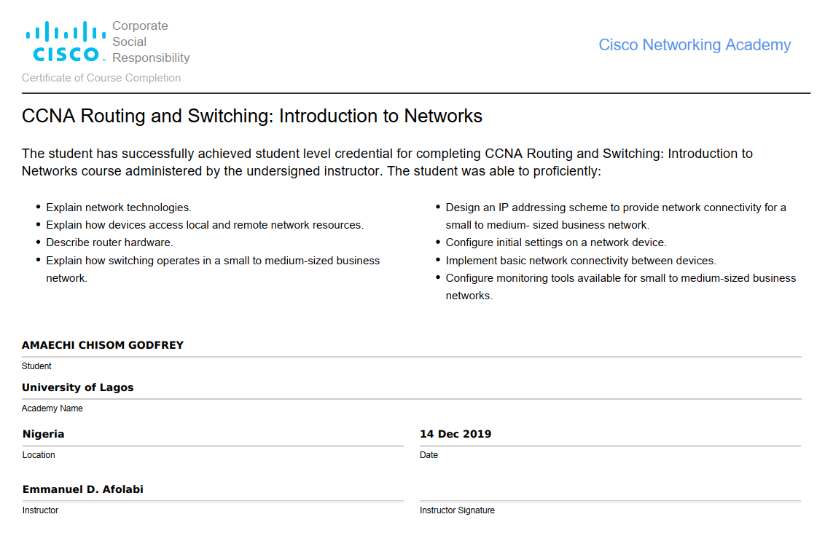
CCNA ROUTING AND SWITCHING

Slide 3
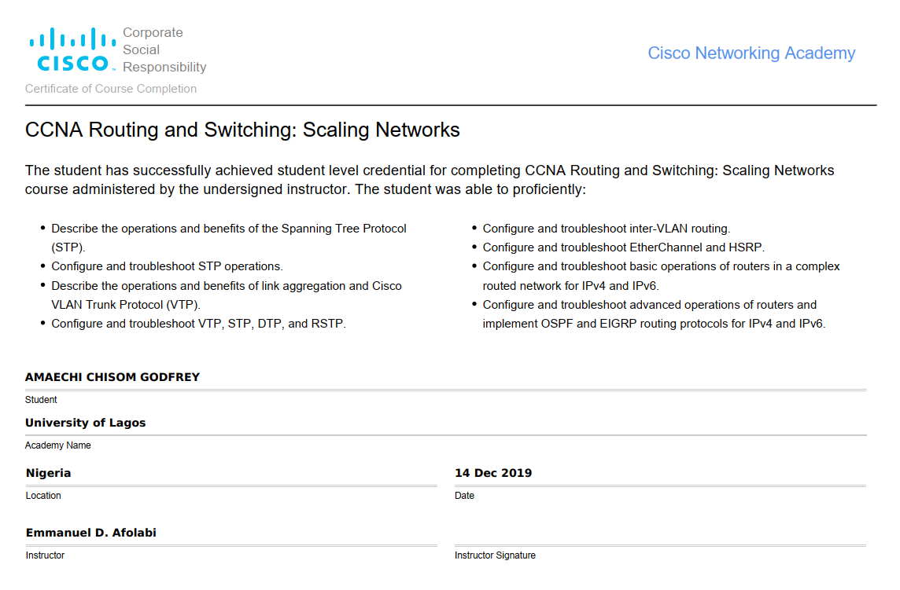
CCNA ROUTING AND SWITCHING

Slide 4
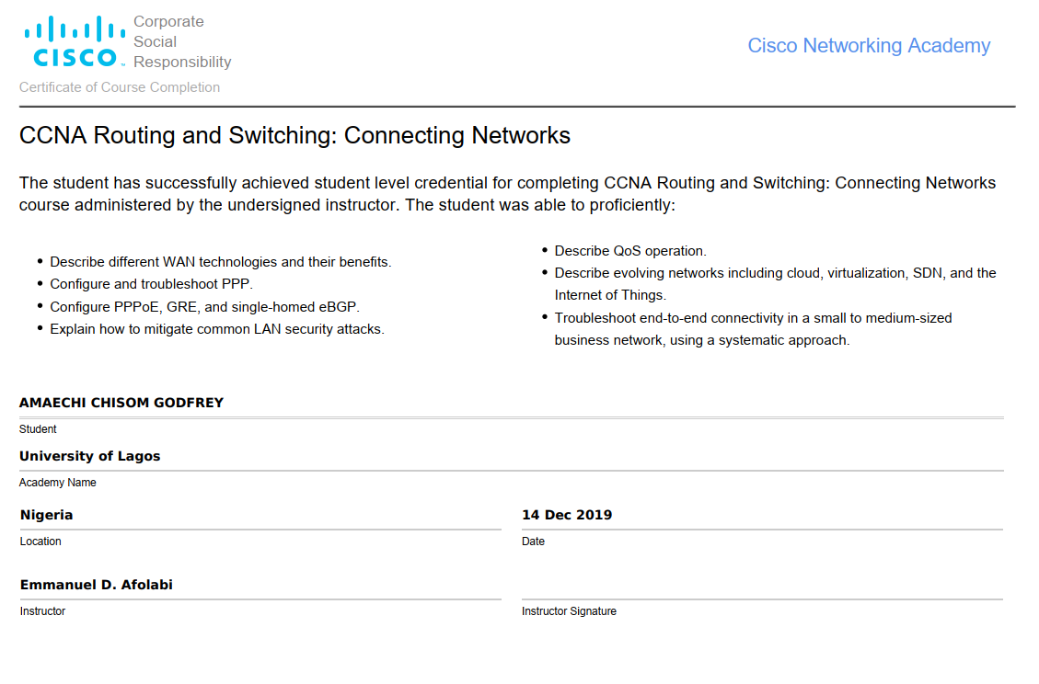
CCNA ROUTING AND SWITCHING

Slide 5
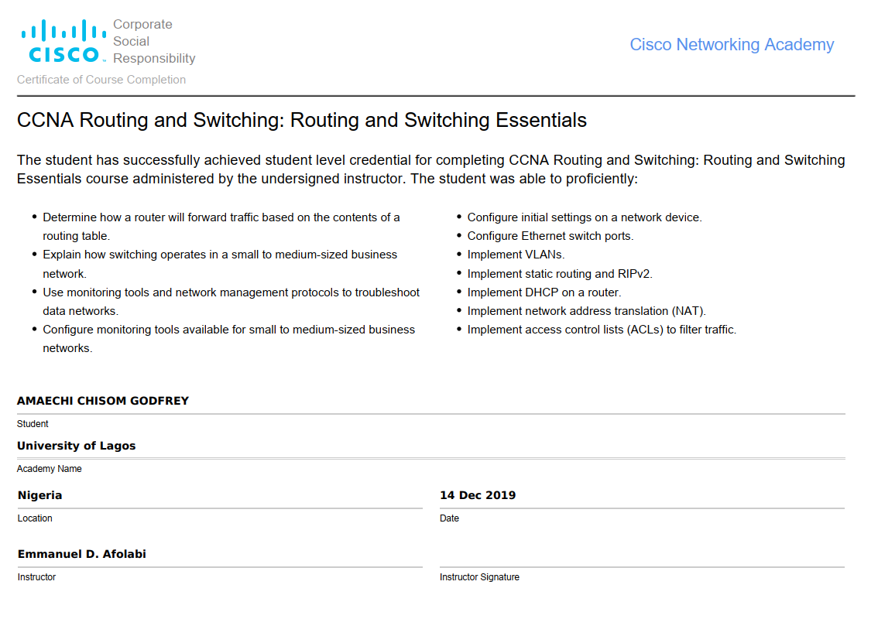
CCNA ROUTING AND SWITCHING

Slide 6
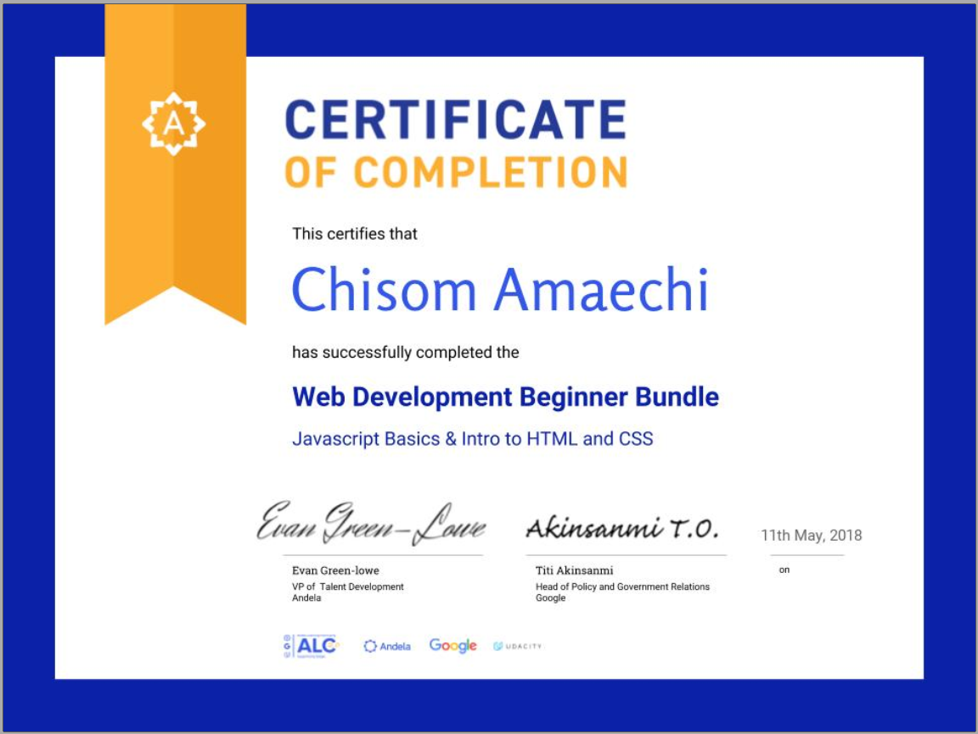
ANDELA LEARNING certificate

Slide 7
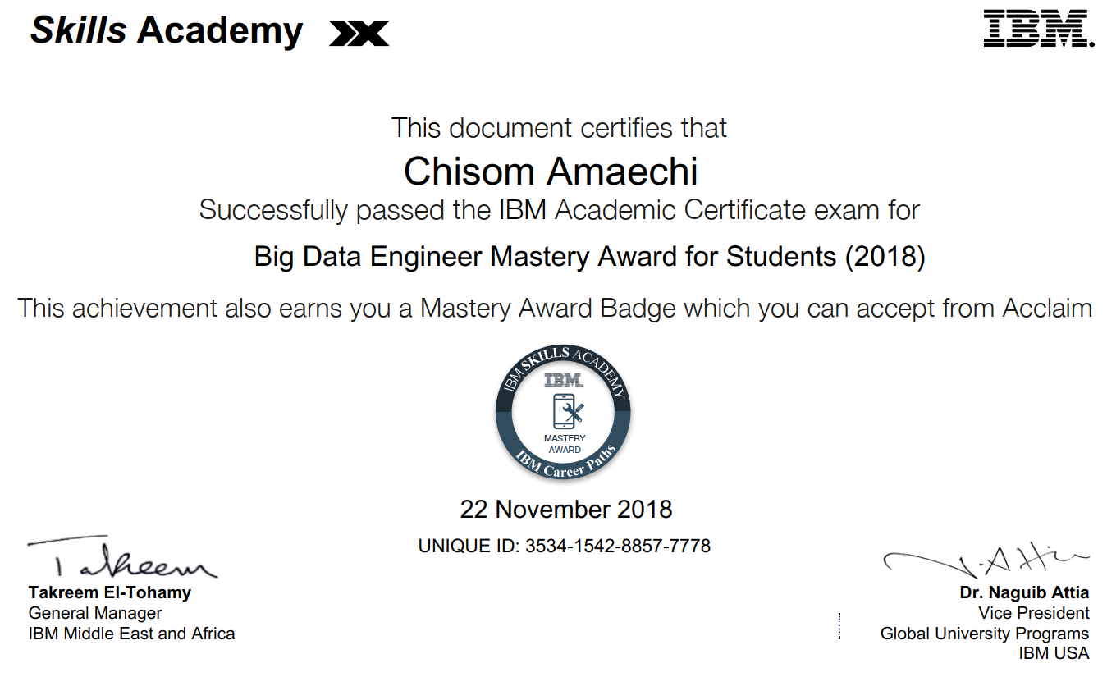
Ibm ACADEMY certificate

Slide 8
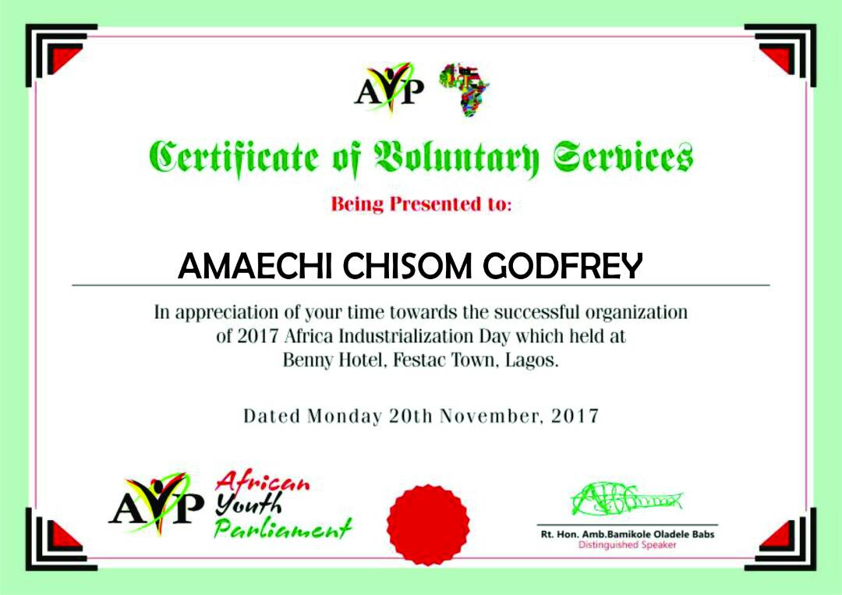
African Youth Partliament

Slide 9
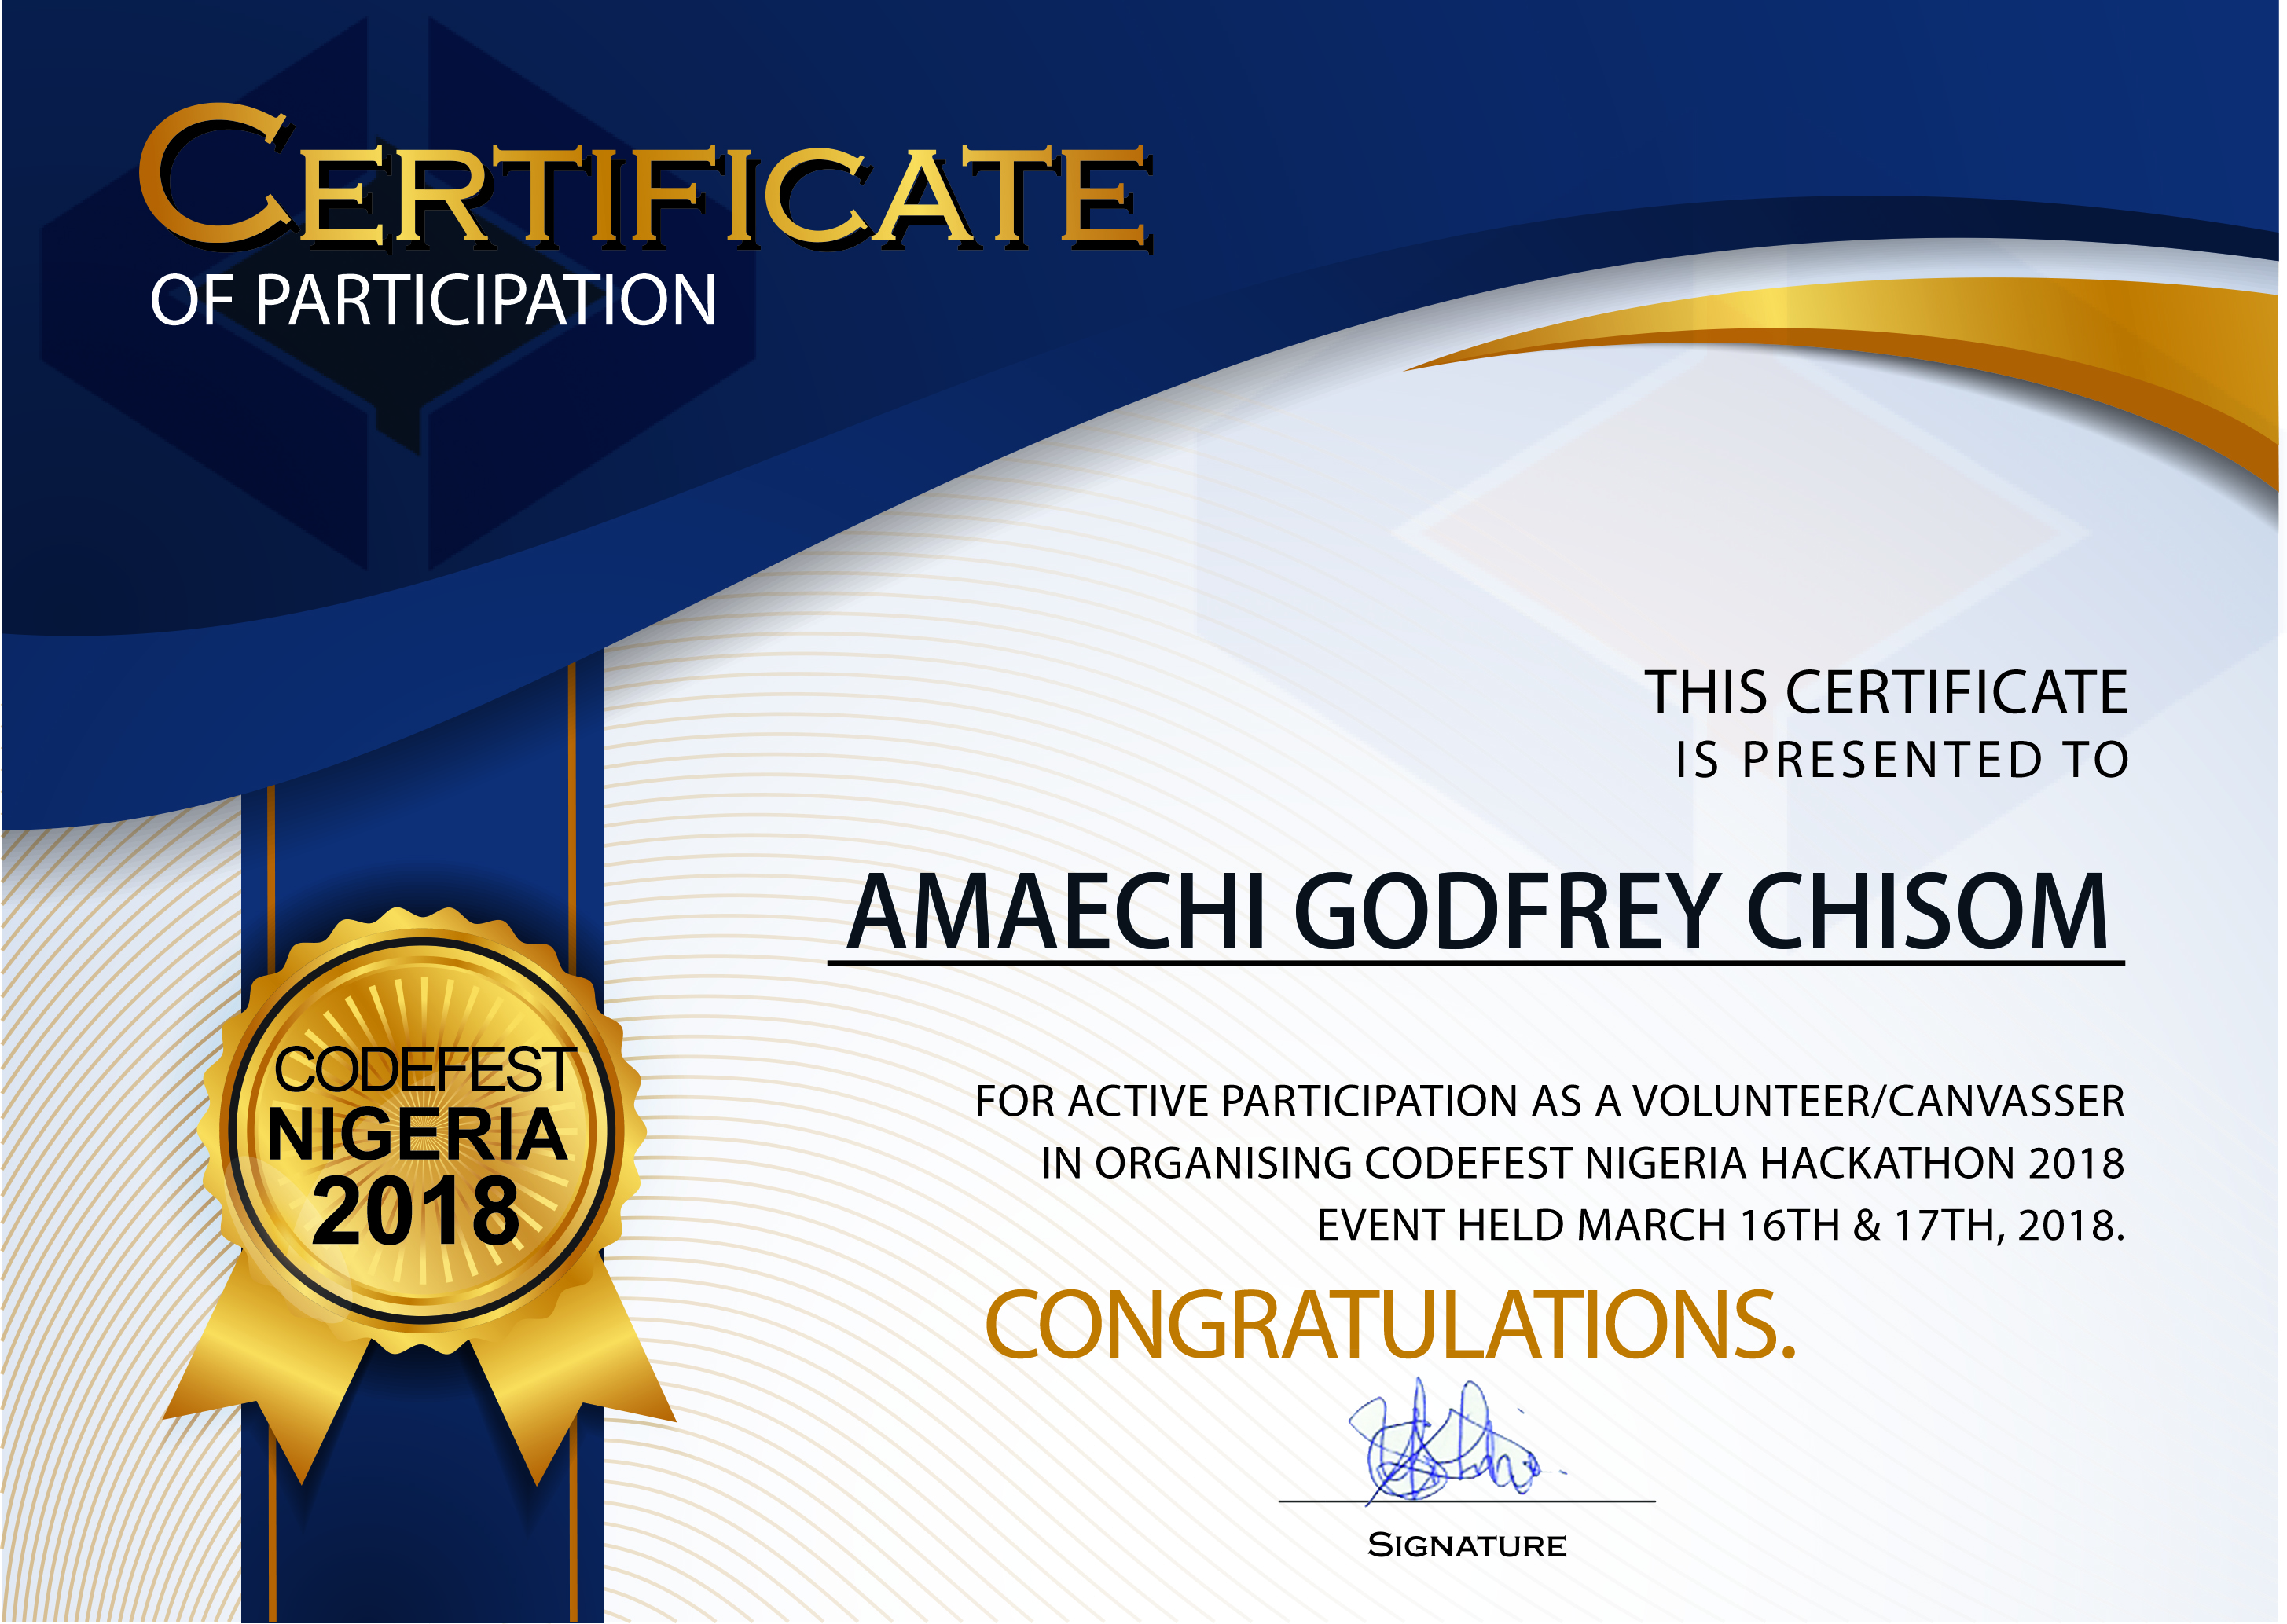
Codefest certificate

Slide 10
A Gallery Of WORKS
By Amaechi godfey chisom

Slide 11
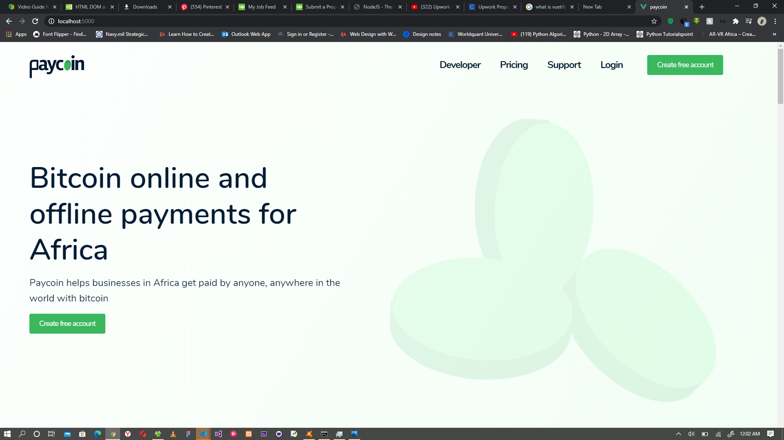
paycoiN

Slide 12

paycoiN

Slide 13

biZFRONTAL

Slide 14
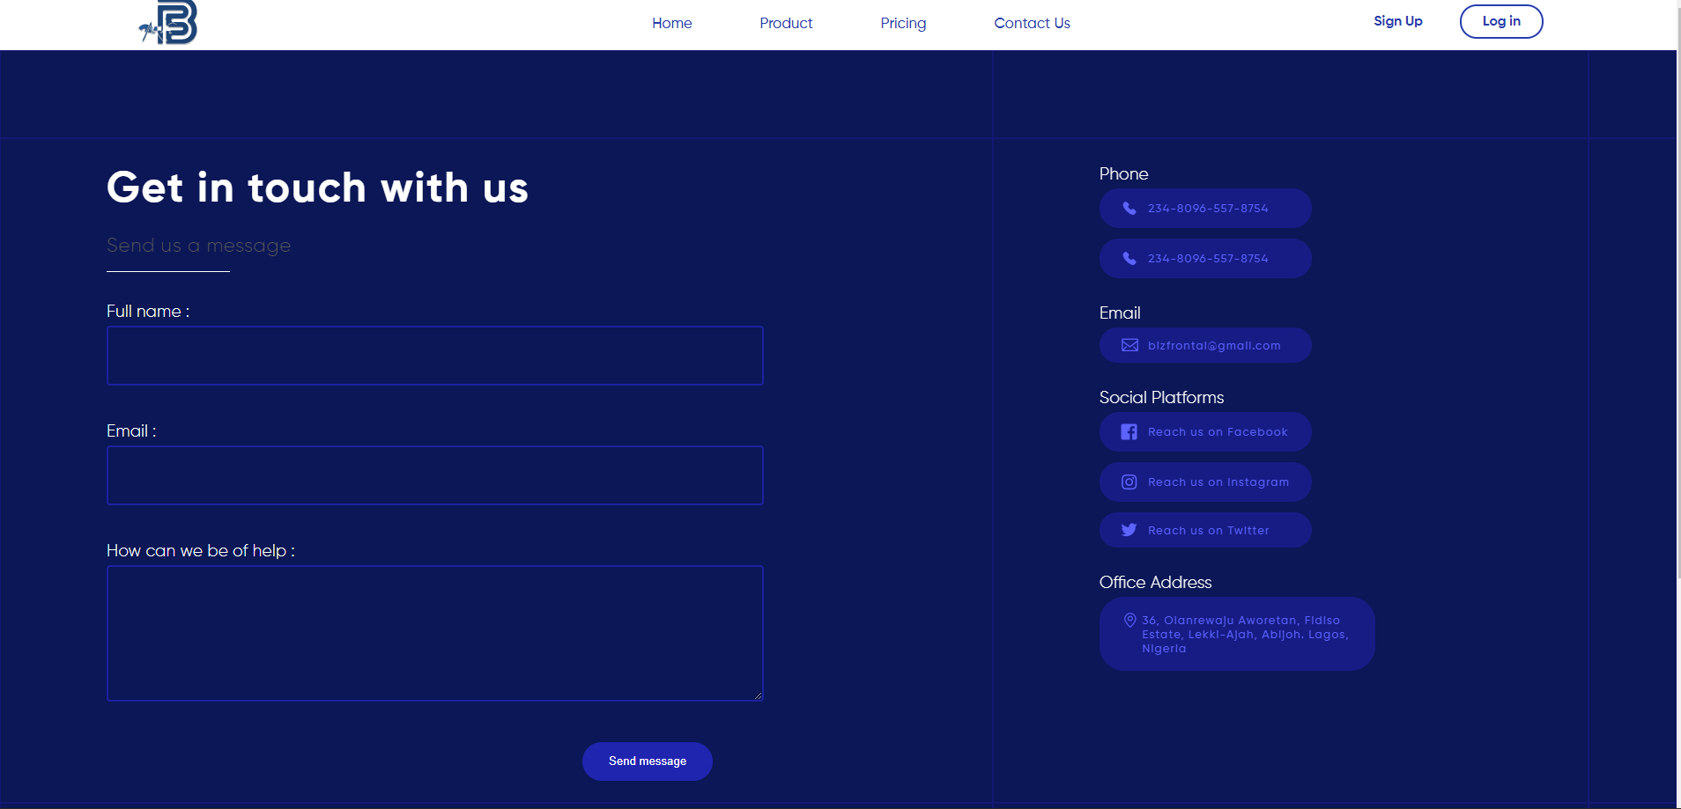
biZFRONTAL

Slide 15

sIXSLATEKAYS

Slide 16
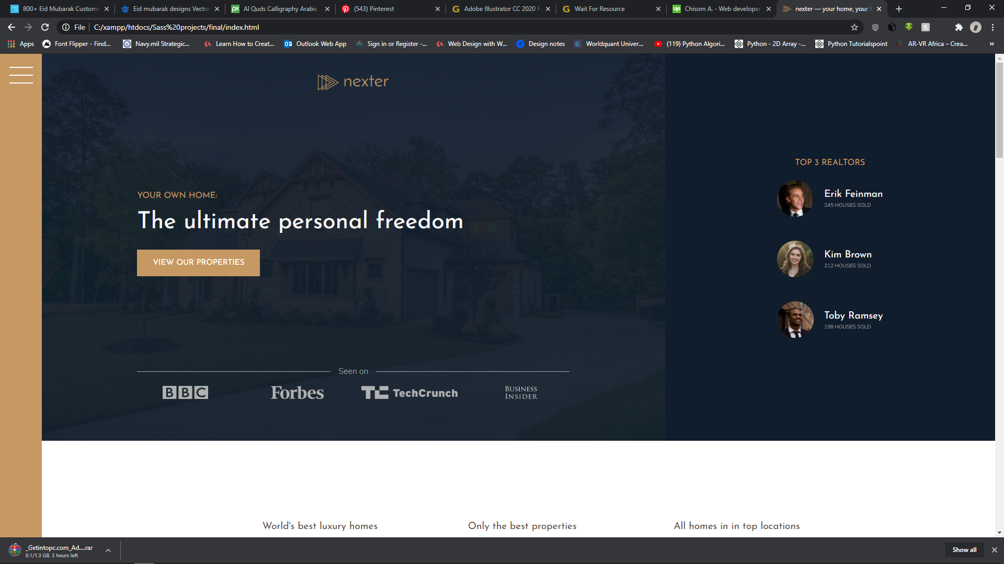
NEXTER

Slide 17
Thank you for viewing!!! Please kindly reach out to me for questions

